Slide 1
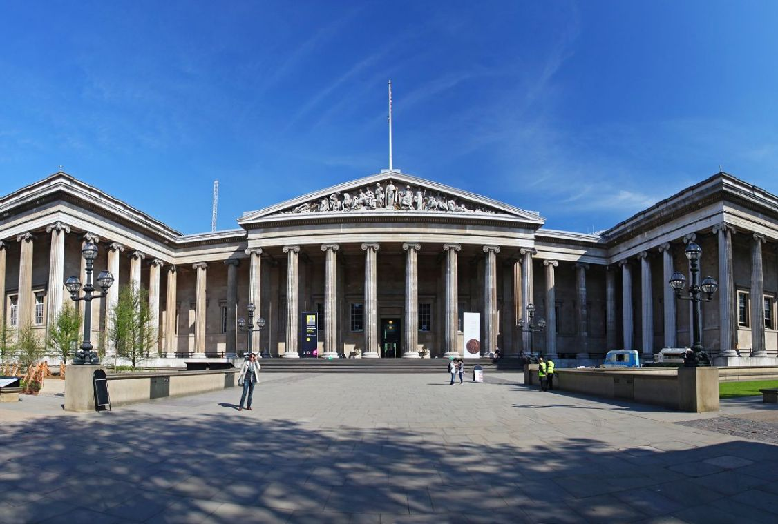
Art Culture

Slide 2

English Literature
Ancient
Renaissance
Romanticism
Early 20th Century
Middle Ages
Neoclassical
Victorian
After WWII

Slide 3
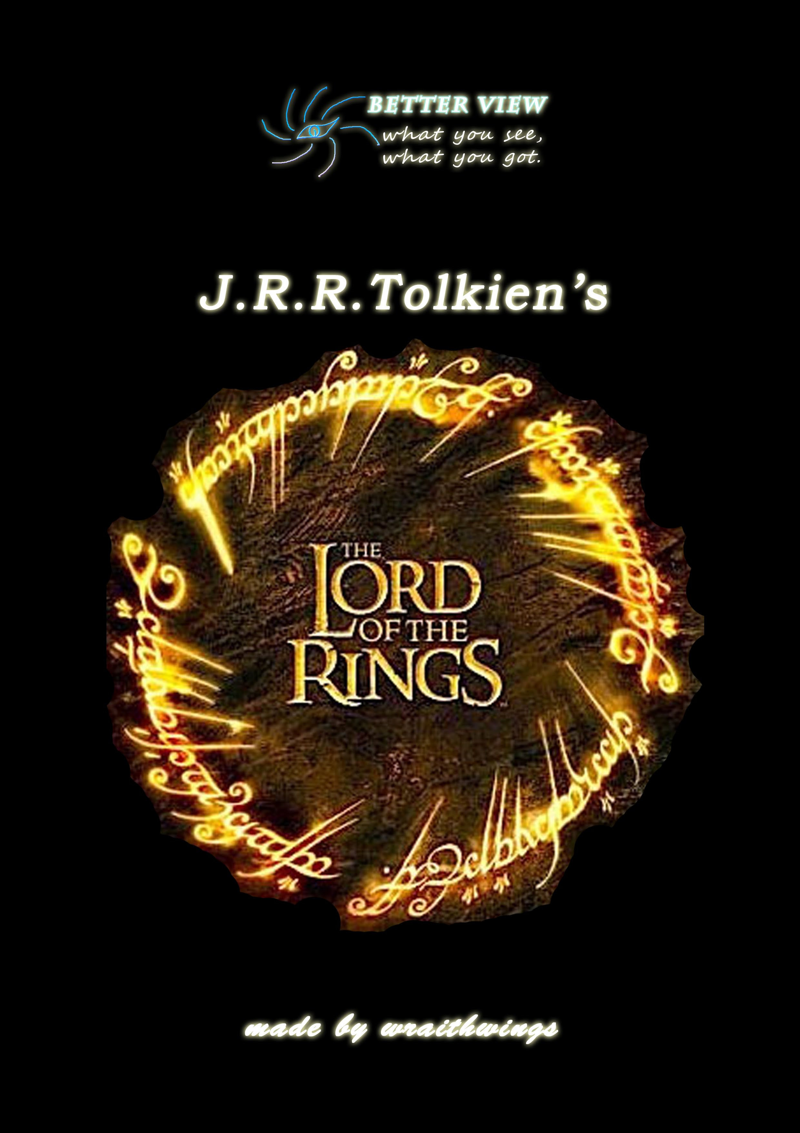
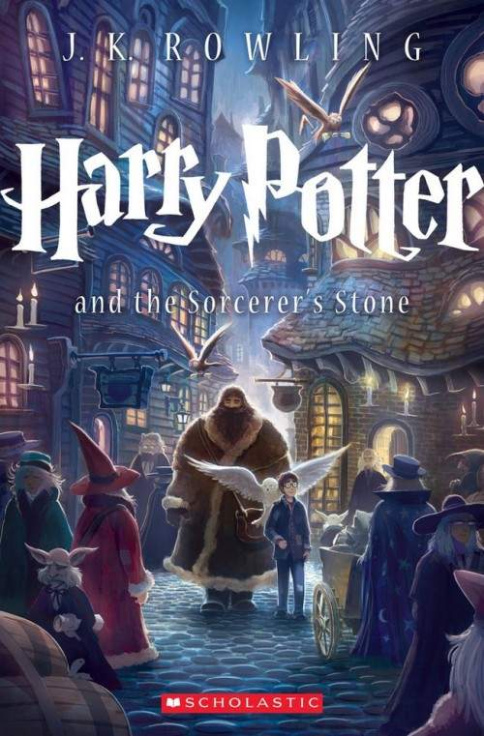
Famous works
The Lord of the Rings
Harry Potter

Slide 4
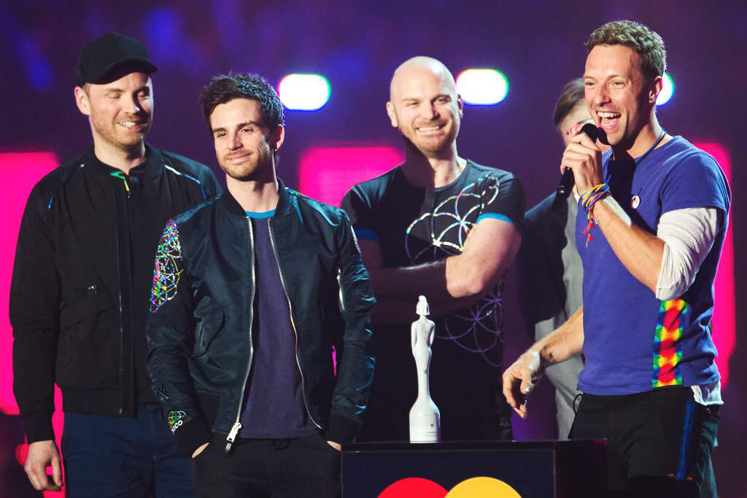
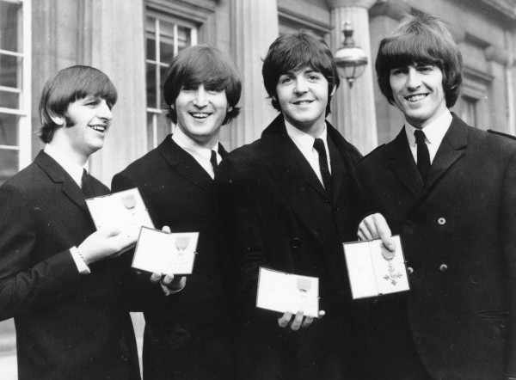
Music
Folk Music
classical music
Early British Pop
Modern British Pop

Slide 5
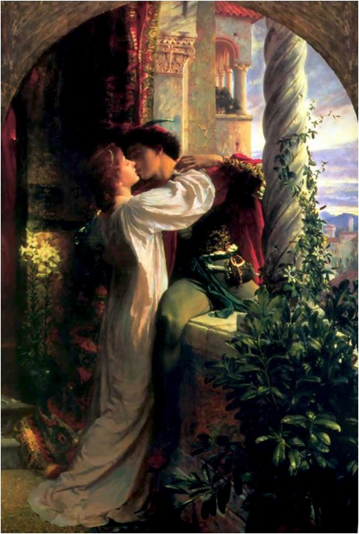
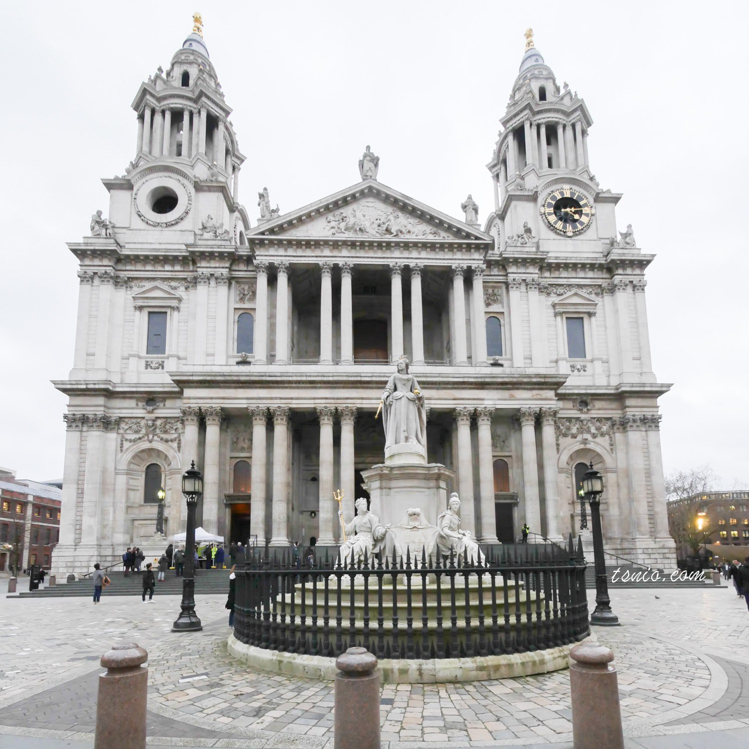
Drama

Slide 6
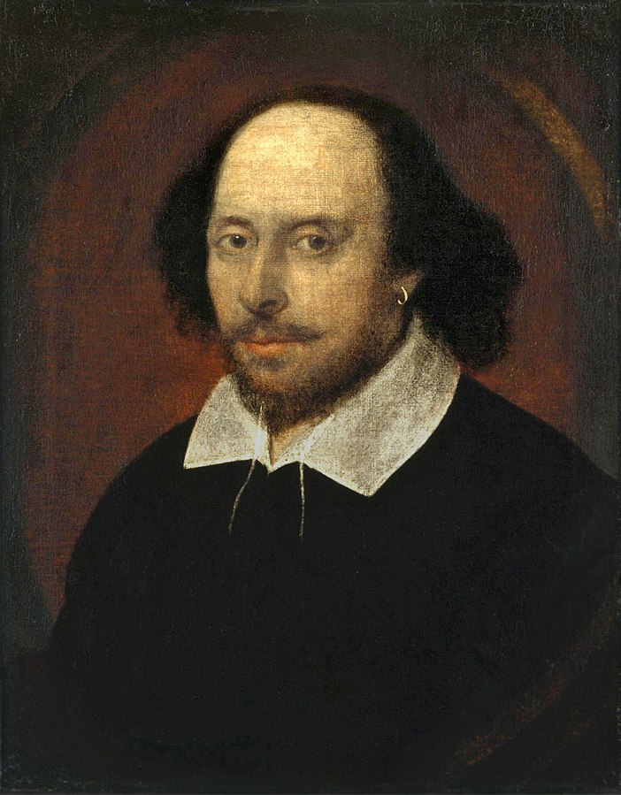
William Shakespeare
Romeo and Juliet
Hamlet
Macbeth
King Lear
Othello
A Midsummer Night's Dream

